Slide 1
From Nonspatial Events to
Polygonal Boundaries!
April 21, 2022
11:00-11:30
John Ehlen
Gistic Research, Inc.

Slide 2
Project Objectives
Automate translation of nonspatial/nontemporal maintenance & engineering boundary definitions from the Performance Controlled System ‘PeCoS’ database into spatial polygon boundaries
Old process was entirely manual
Conflate boundary events to support other data and processes
SDE Events / Data visualization & dashboarding
Connect Data Silos
Perform Quality Control

Slide 3
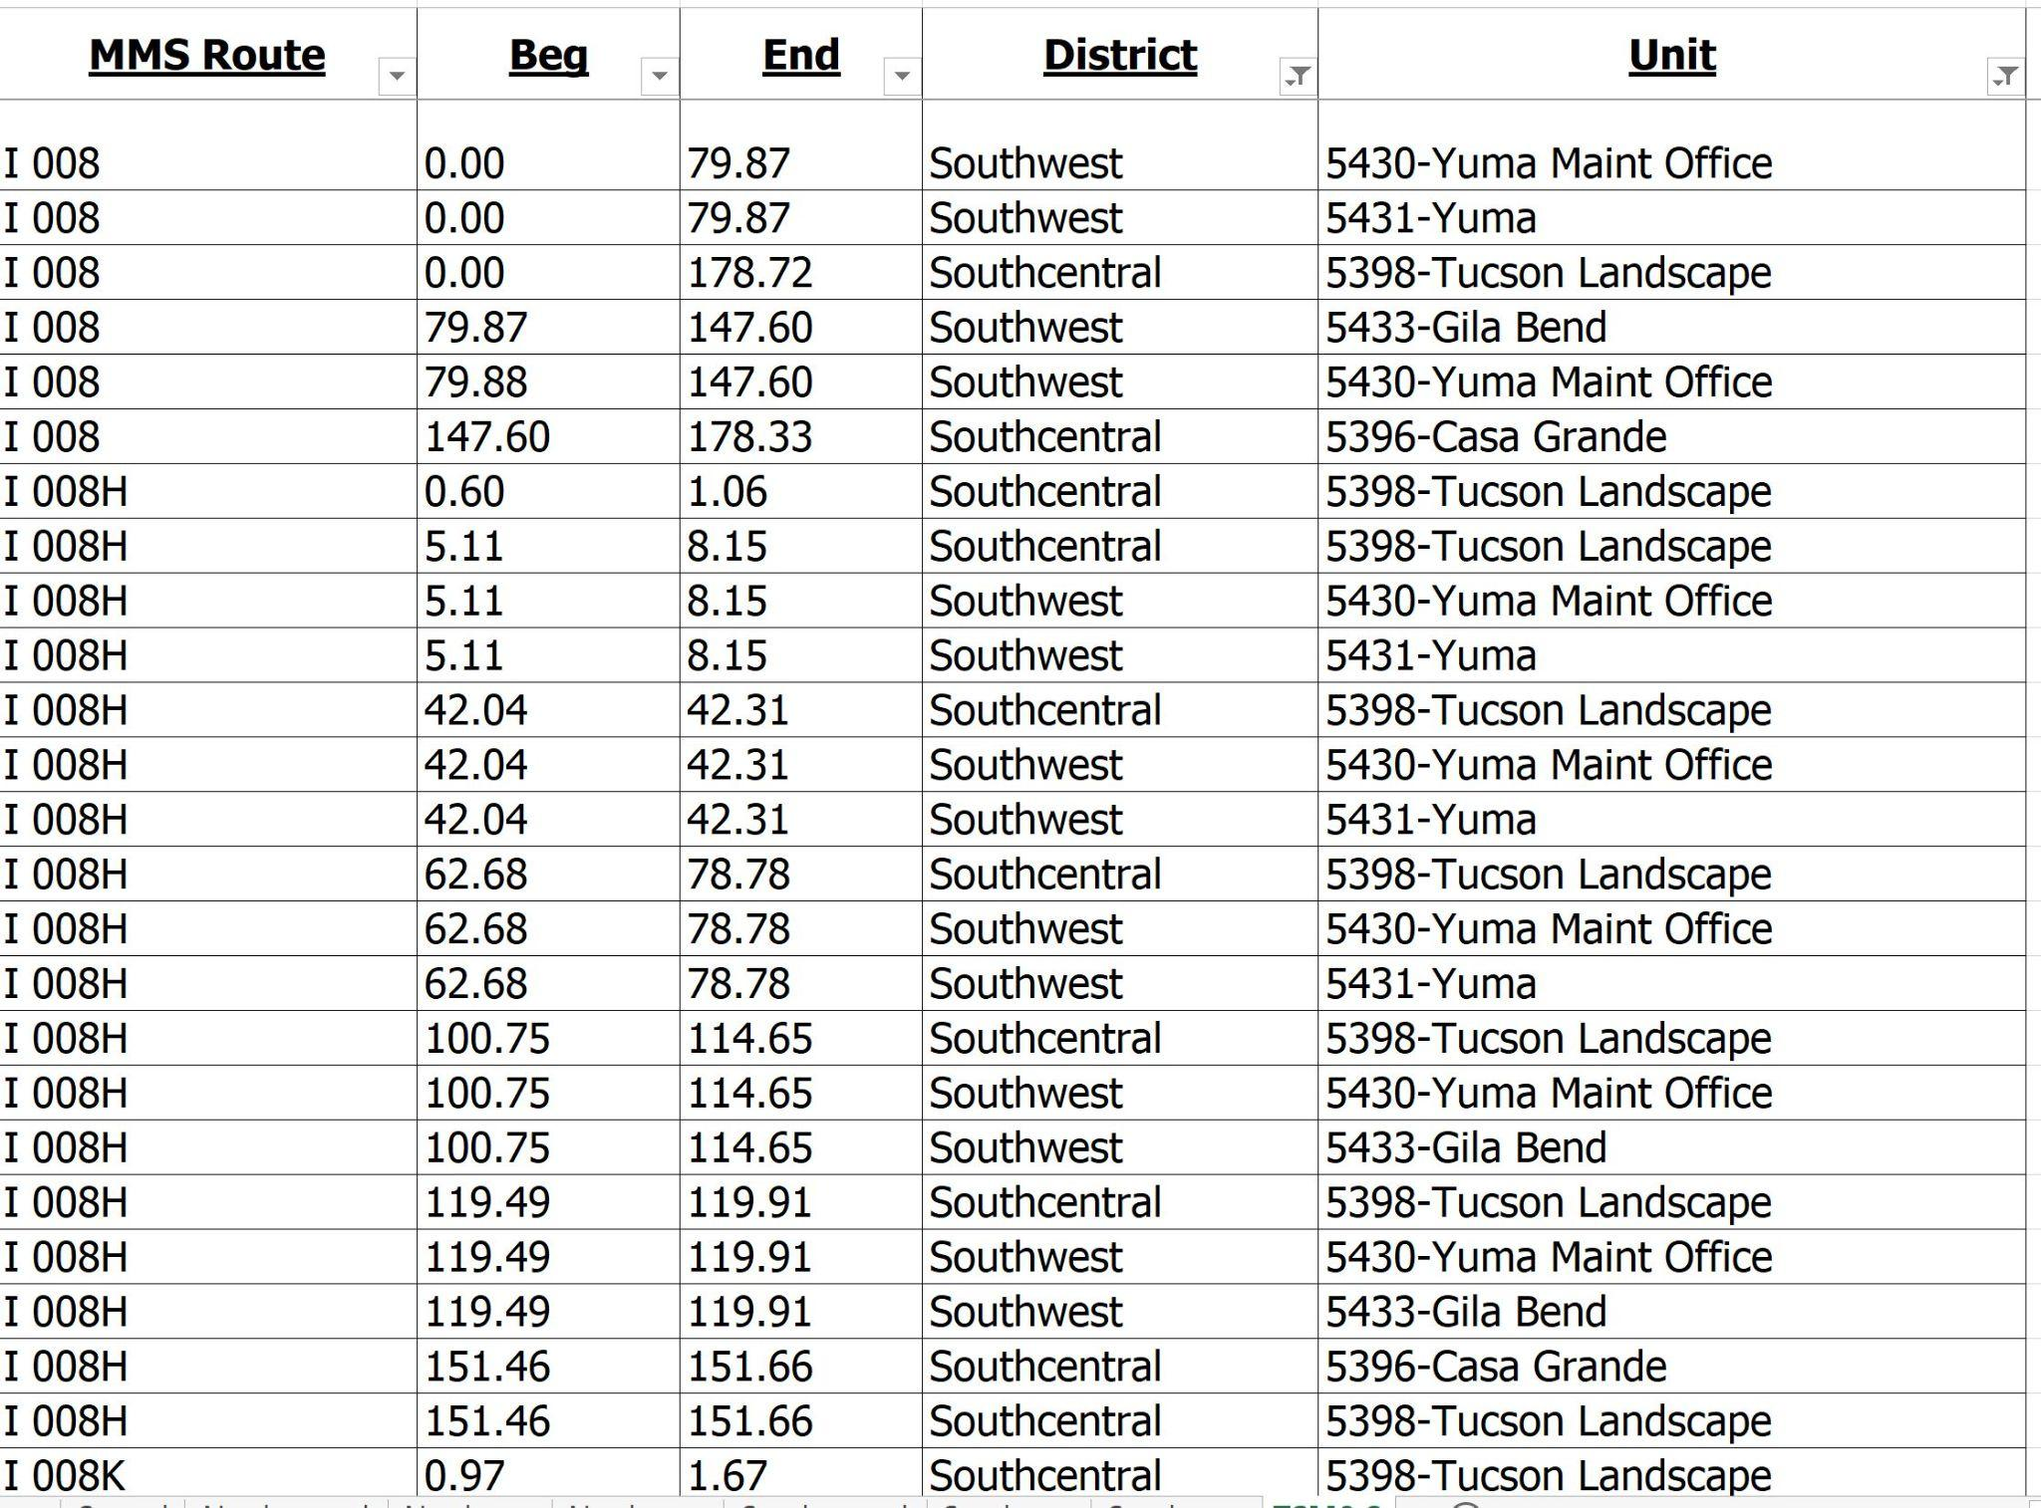
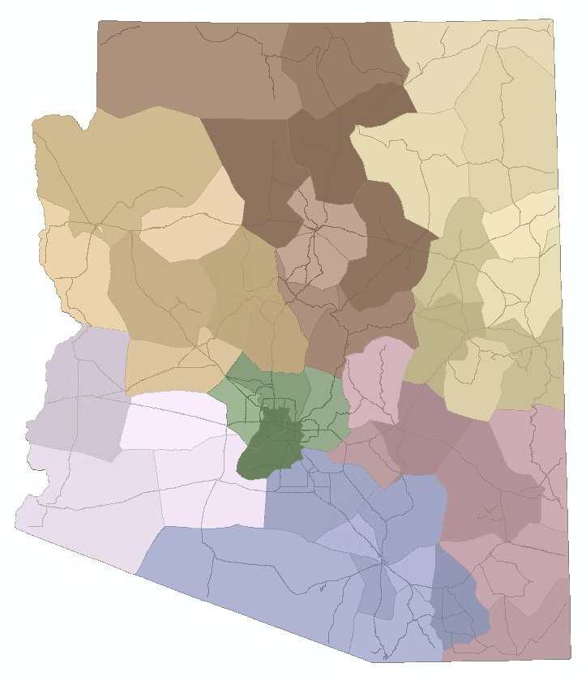
Process Goal
Notes:
A screenshot of the nonspatial PeCoS table is on the left. This table refers to routes and milepost ranges that are maintained by specific road crews. The ‘Beg’ and ‘End’ columns in this table refer to beginning and ending mileposts on a route that are maintained by a specific maintenance unit.
The desired linear and polygonal output is on the right, which is a spatial representation of the same linearly referenced events.

Slide 4
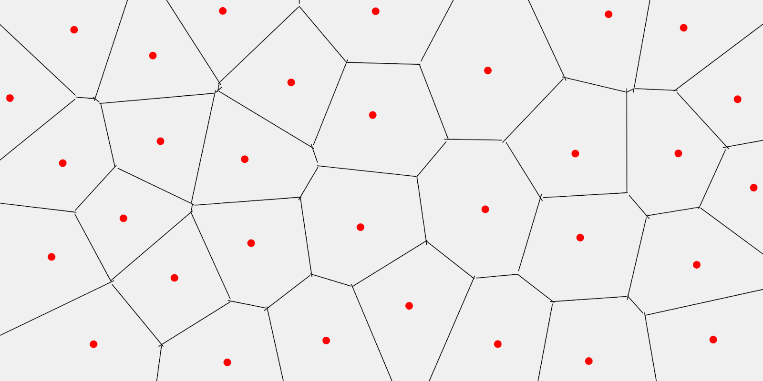
The Magic Ingredient: Voronoi Diagrammer
Creates convex polygons around points
Each polygon contains exactly one origin point
Every point in a given polygon is closer to its generating point than to any other point.
Notes:
The magic of this process is really a specific transformer in FME called the Voronoi Diagrammer which is another term for a thiessen polygon.
The Voronoi transformer is really cool. If you have a point dataset, it draws polygons around each individual point. Every location within each polygon is closer to the point contained within the polygon than any other point in the workspace. This transformer is what allows us to draw polygon boundaries around our events.

Slide 5
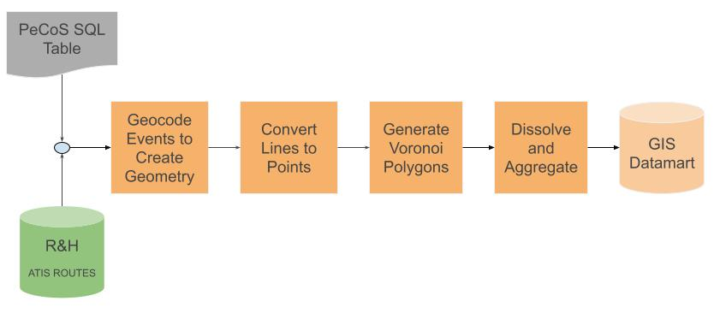
Process Summary
Notes:
This flowchart summarizes the FME polygonizaton process
There are 2 data inputs for this process: The route dataset from the Roads and Highways database and the nonspatial maintenance event table from the PeCoS database.
We first geocode the nonspatial maintenance event table to obtain event geometry.
Once we have linear geometry, we split the lines into points, because the Voronoy diagrammer requires point input.
Then finally, the Voronoy diagrammer generates polygons around the points.
I would also like to point out that at many steps of the process we log data bugs, which are automatically emailed to the appropriate recipient in Excel spreadsheets.

Slide 6
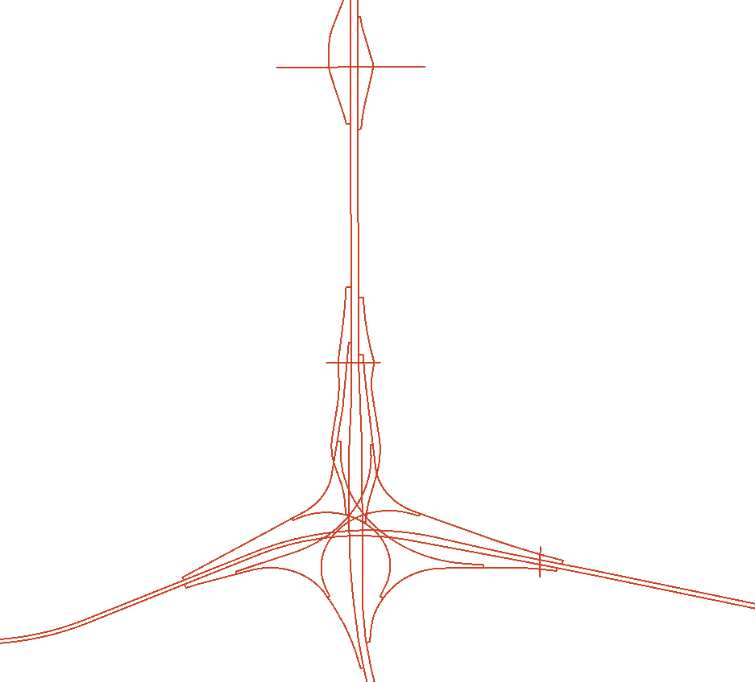
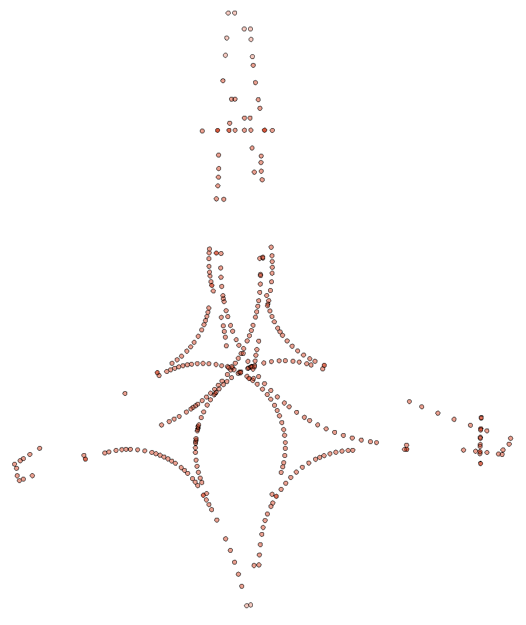
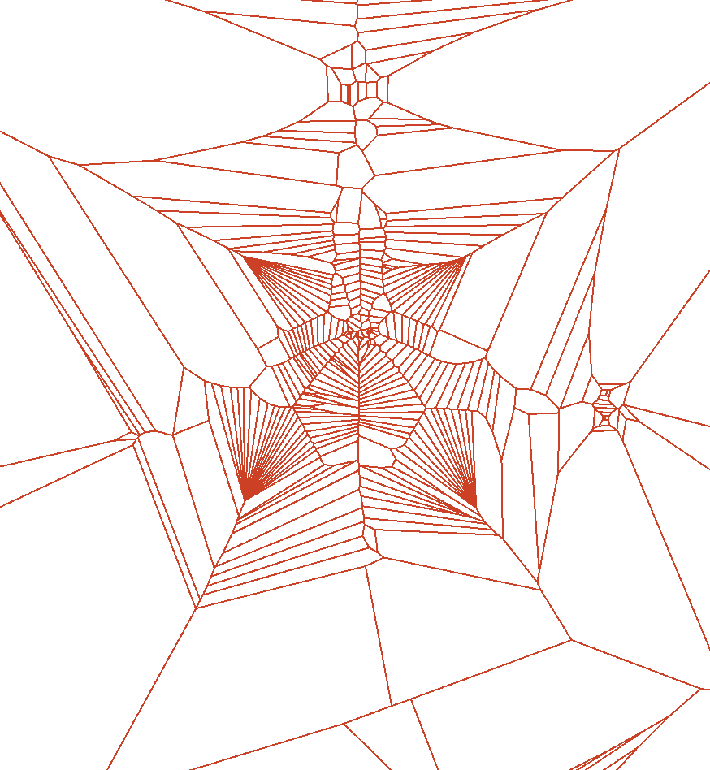
FME Intermediate Output
Intersection of I-10 and SR-202
Geocoder Output
Vertice Extraction
Voronoi Diagrammer Output
Notes:
Now let’s take a look at the data as it goes through the FME process. These three screenshots were taken from critical intermediate outputs within the FME process. Each screenshot illustrates the same intersection, where I-10 intersects State Route 202, on the Phoenix/Chandler border in Maricopa County.
The screenshot on the left shows the linear output of the geocoder.
The center screenshot shows the point output of the chopper, which is a transformer we use to extract the vertices on the lines, thus converting the lines to points.
We then feed these points into the Voronoy Diagrammer, which generates polygons around each point. These polygons look pretty crazy, but when we dissolve and aggregate these spider web looking polygons on the maintenance Units and their parent engineering districts, we get beautiful polygonal boundaries.

Slide 7
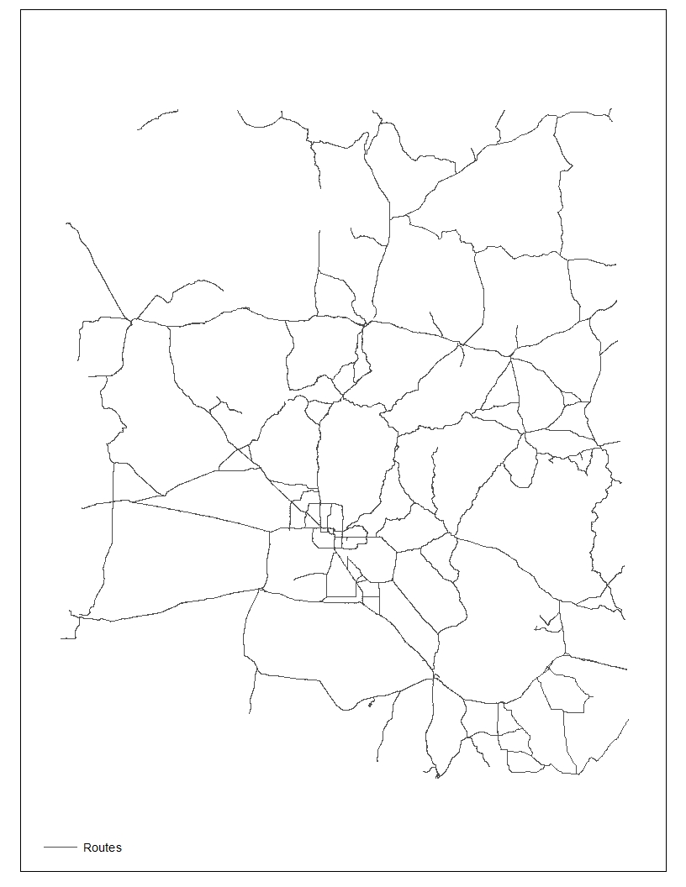
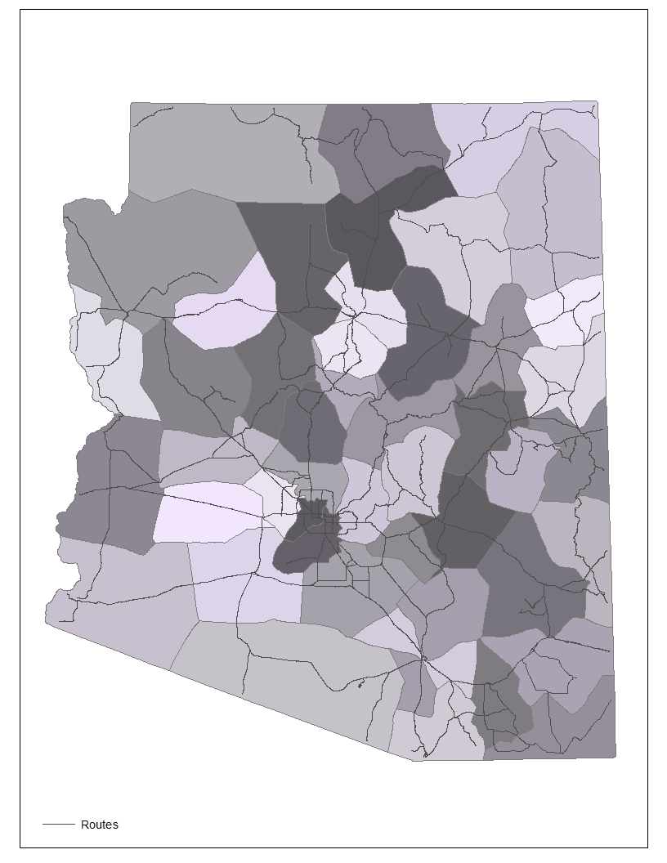
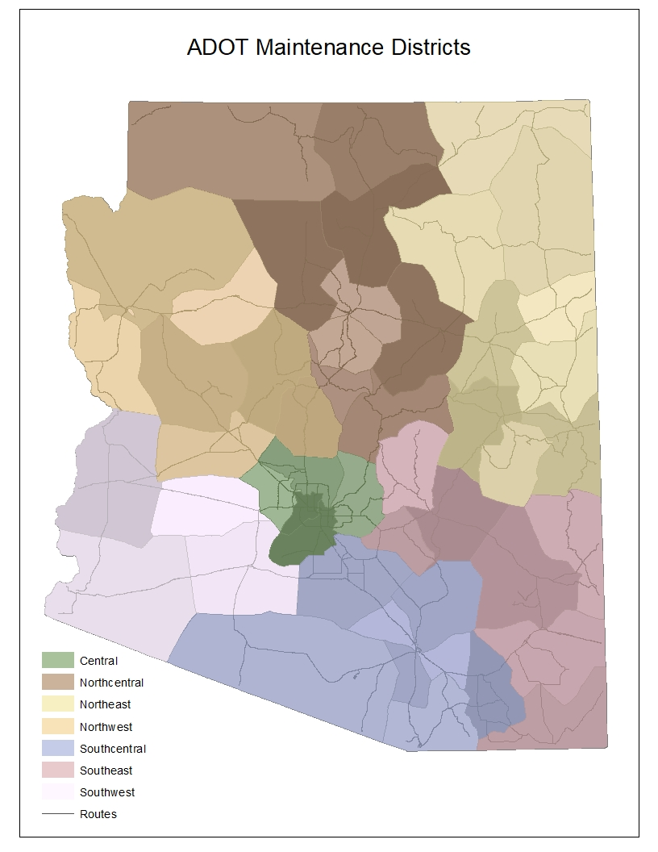
Process Output
Spatial Linear Output
Maintenance Unit Output
Engineering District Output
Notes:
Now, let’s take a look at the process output.
First, we see the spatial linear output of the process
Next, we see the polygonal maintenance unit output. The Voronoy process drew these polygons around the lines.
Finally, we see the engineering district output, which is an aggregation of their child maintenance units.

Slide 8
Identifying Errors and Data Validation
The output of this process allow us to see data issues that are hard to spot in the tabular format of the PeCoS Database.
Examples on following slides
Notes:
As we mentioned previously, this process also has many data validation and QC steps baked in. On the next few slides I will show examples of data bugs that we have found using the polygonization process.

Slide 9
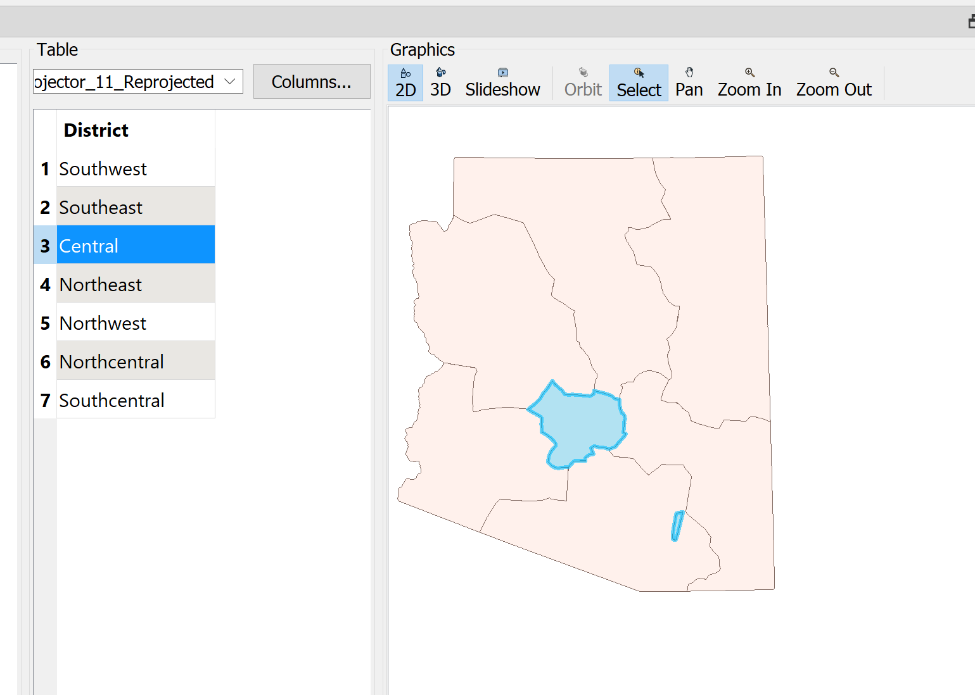
Identifying Errors and Data Validation
The Engineering District polygons represent parent groups of Maintenance Units.
Data bug: There should be no disconnected polygons in Engineering Districts.
Notes:
As we examined the process output we found something interesting. There were a lot of little bugs in the nonspatial PeCoS table that may have existed for years, however, the PeCoS table is not temporal so the time extent of these bugs is unknown.
It’s pretty hard for humans to digest tabular data, and the road crews didn’t realize the table didn’t match what they were doing out in the field.
When we drew polygons around the nonspatial events, we found anomalies like this one in the engineering district polygon output. In this instance, there was a small area of the state that was attributed to the Central district, yet far away from the main body of the Central district.
This visual output allowed us to find that a road segment within this outlying Central polygon was incorrectly assigned. This has since been fixed, and I added a QC check in FME that identifies these tiny, disconnected polygons.

Slide 10
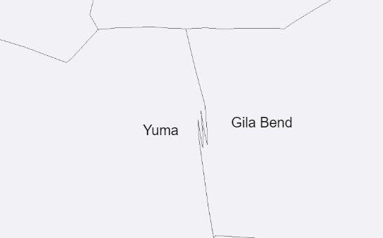
Identifying Errors and Data Validation
Notes:
This jagged boundary between maintenance units was caused by a discrepancy in the PeCoS database that indicated a small section of frontage road on Interstate 8 was being maintained by a different maintenance unit than the corresponding mainline roadway.
When the Voronoy diagrammer drew polygons around these areas it resulted in a jagged boundary.
On the ground, the frontage road and mainline in this area are maintained by the same maintenance unit. The PeCoS database has been updated to reflect this reality, and the polygonal boundary output is no longer jagged.

Slide 11
Conclusion
ADOT has historically used the nonspatial PeCoS database to track road maintenance responsibility.
This database is not part of the spatiotemporal Roads and Highways database
Difficult to incorporate into GIS analyses.
The use of FME to create polygons allows:
Silo connection
The generation of a spatiotemporal history
Easy identification of data quality issues
Integration into the LRS
At this point I’d like to open the floor to discussion and questions. Also, please feel free to reach out to either of us at any time.
Notes:
In conclusion, ADOT has historically used the nonspatial PeCoS database to track which roads are maintained by which maintenance units. However, this database is not part of the spatiotemporal roads and highways database, and has been difficult to incorporate into GIS analyses.
We used FME to create polygons from a nonspatial LRS event table, which also identifies data quality issues and creates a temporal history of the linear and polygonal maintenance events. Thank you for joining me today.
At this point I’d like to open the floor to discussion and questions. Also, please feel free to reach out to either of us at any time.

Slide 12
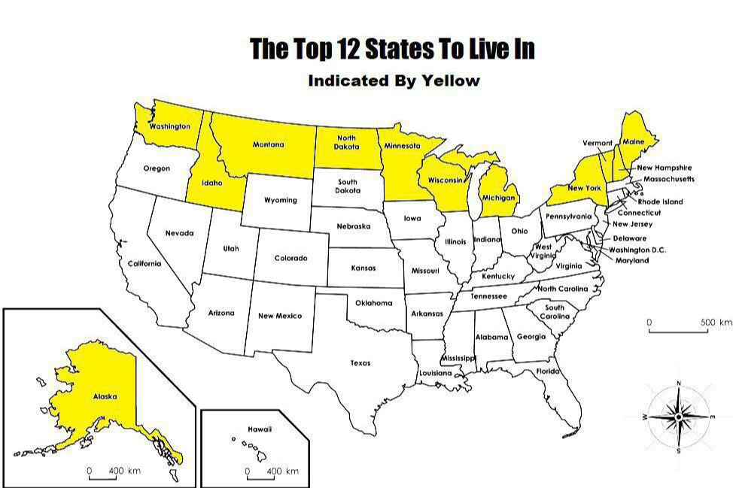
Questions?
Source: Terrible Maps, 2021
John.Ehlen@gisticinc.com
Notes:
In conclusion, ADOT has historically used the nonspatial PeCoS database to track which roads are maintained by which maintenance units. However, this database is not part of the spatiotemporal roads and highways database, and has been difficult to incorporate into GIS analyses.
We used FME to create polygons from a nonspatial LRS event table, which also identifies data quality issues and creates a temporal history of the linear and polygonal maintenance events. Thank you for joining me today.
At this point I’d like to open the floor to discussion and questions. Also, please feel free to reach out to either of us at any time.

